Slide 1
Alexey Gorbatenko (CV)
MARKETING RESEARCH EXECUTIVE

Slide 2

TNS (MIC) (10.2006 - 03.2007)
PROJECT MANAGER ASSISTANT
Responsibilities
Prepare reports (Power Point)
Questionnaire design
Data analysis (Galileo)
Achievements
Improved Power Point skills
Prepared presentations for companies P & G, Boehringer, Lebedyansky etc.

Slide 3
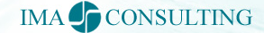
IMA-Consulting (08.2007 - 05.2008)
About company: «IMA-consulting» - full cycle consulting agency founded in1999.
Main services: PR (Press-actions, Antirecessionary PR, etc.), Monitoring of mass-media and media-analytic, Government Relations and Marketing research,
Clients: Government organizations, Financial and insurance companies, Energy, Industry, Retail, IT, Telecommunications and Internet-Business
ASSOCIATE PROJECT MANAGER
(RESEARCH DEPARTMENT)
Responsibilities:
Reports writing
Data analysis (SPSS)
Questionnaire design
Field management
Achievements:
Management of 10000 interviews during pre-election projects
Grew to project manager
PROJECT MANAGER
(RESEARCH DEPARTMENT)
Responsibilities:
Writing proposals and communication with clients
Management of complete cycle researches
Sophisticated data analysis (factor/cluster/regression in SPSS)
Report writing (quantitative /qualitative data)
Achievements:
Managed relationships and projects for the key client (revenue 220 000$ per year)

Slide 4

Kleffmann Group (04.2008 – present)
About company: Founded by Burkhard Kleffmann in Germany in 1990, Kleffmann Group today is the world leader in agricultural market research. A multinational company, operates in more than sixty countries worldwide
Vision: Using a complete portfolio of methodologies and analysis tools, provide innovative agribusiness information solutions.
Clients: Crop Protection Producers (BASF, Bayer, Syngenta, DuPont), Seed companies (Rijk Zwaan) Government organizations etc.
Responsibilities:
Organization full cycle studies:
Preparation of proposals for study and calculation of project resources.
Development of research tools (guides / questionnaires)
Tools translation (Russian / English)
Interviewers instruction , pilot, supervision of data collection.
Communication with the data processing unit in Poland / self managed data analysis (SPSS)
Report writing on quantitative and qualitative data (including translation to English)
Personal presentation of results to clients.
Achievements:
Managed ad-hoc projects for the key clients (Bayer, BASF, Syngenta, Du Pont)
Working group supervision (3 persons)
Improved the quality of reports (improved visualization, analytical findings, intru executive summary preparation )
Increased customer satisfaction (based on annual monitoring of satisfaction). Increase number of positive feedbacks on the ad-hoc studies.
Carried out research projects of high complexity: Rijk Zwaan (decision to move the office), Rosnanotechnologies (launch of innovative croup protection product), BASF (complex analysis of rodenticide market and prospects the company's products)

Slide 5

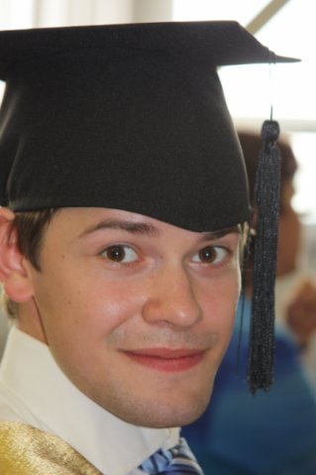
Education
2009 - Higher School of Economics (SU-HSE), marketing, master
2007 - Higher School of Economics (SU-HSE), management, bachelor
Key achievements:
In top 5% of the best students of the HSE management faculty the 2009.
Average score 8.51 (10 point system evaluation)
In 2004 first place in the ranking of performance among more than 250 students

Slide 6
Advanced trainings/courses
2005 — Market Economy Fundamentals Dr. L. Wayne Gertmenian, AIESEC,
2006 — International student exchange program W&T (USA, Batavia, NY), CIO &CHI (4 month)
2007 — Statistic analysis (SPSS), SU-HSE
2007 — School of moderators, FOM (Public Opinion Foundation),

Slide 7
E-mail alexey.gorbatenko@gmail.com
Phone (cell) +7 (915) 420-82-71
Phone (home) +7 (495) 953-05-04
Salary 1 500 EURO (net) + bonus
Date of birth 13.08.1985
Languages English (Intermediate)

